Slide 1
Tracking Accuracy Comparison HTC vive vs. Vicon (ongoing)
Yuanqing Hong, Xin Jin, Antonio Prado, Boxi Xia

Slide 2
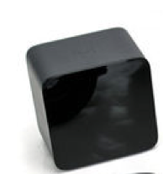
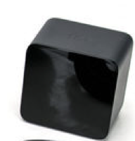
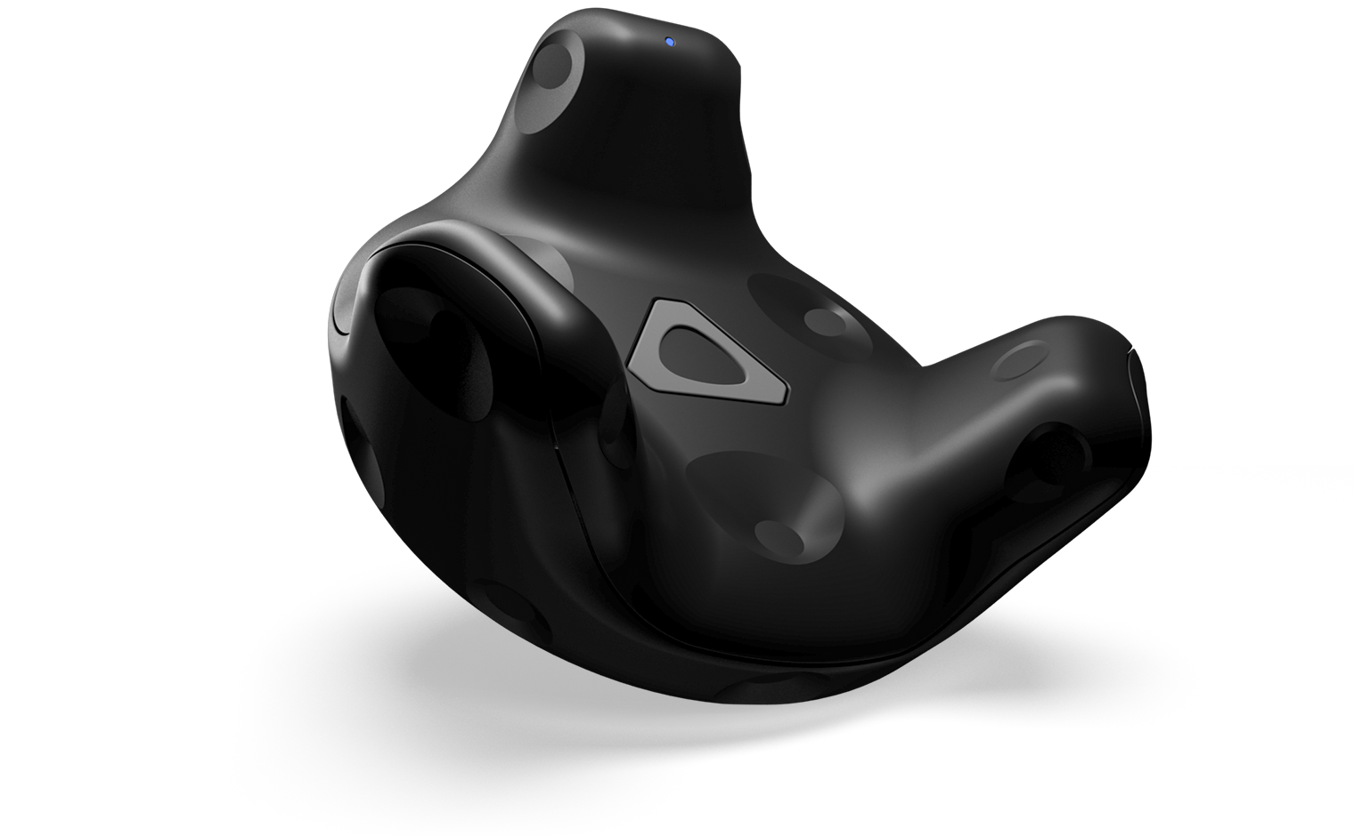
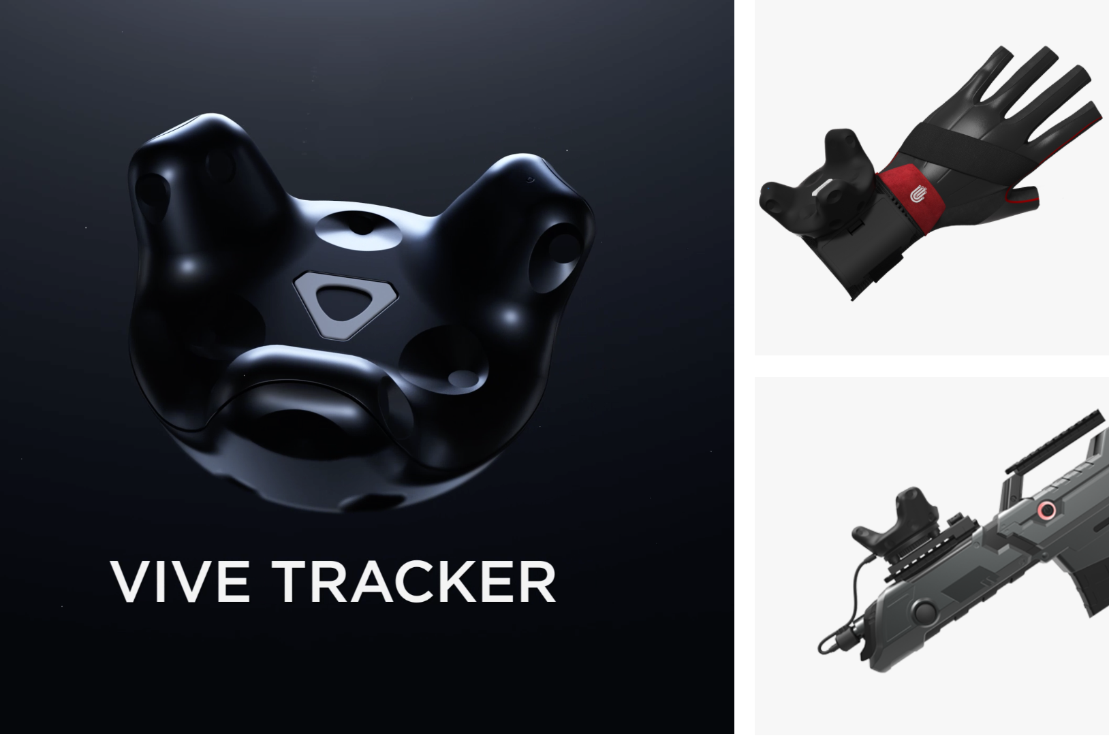
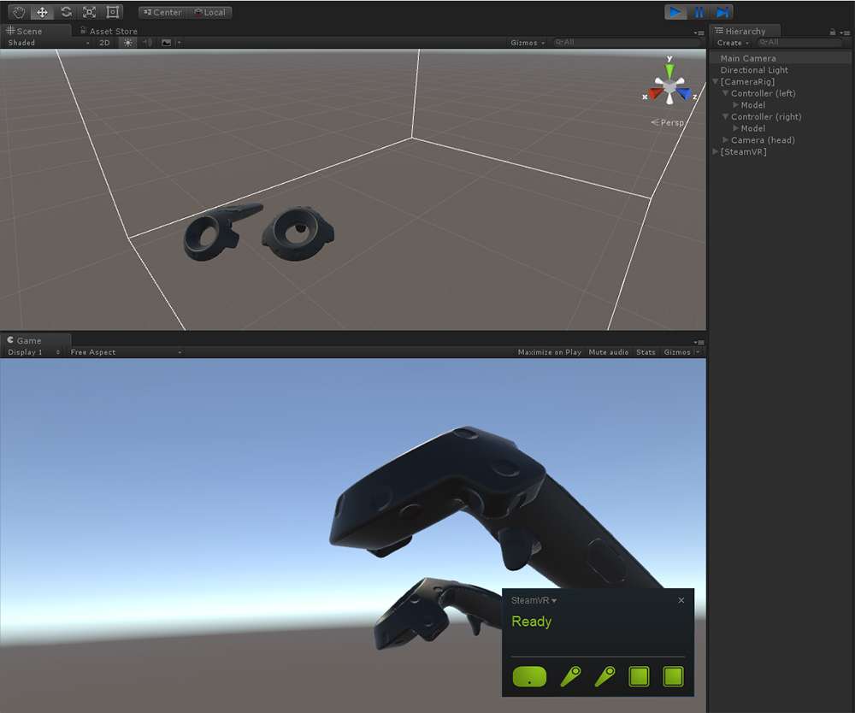
HTC vive VS. VICON
Base Stations VS. Cameras
Trackers VS. Markers
2 Lasers provide
Vertical and Horizontal
Frequency 120 Hz
Gyroscope
Accelerometer
Frequency 250Hz

Slide 3
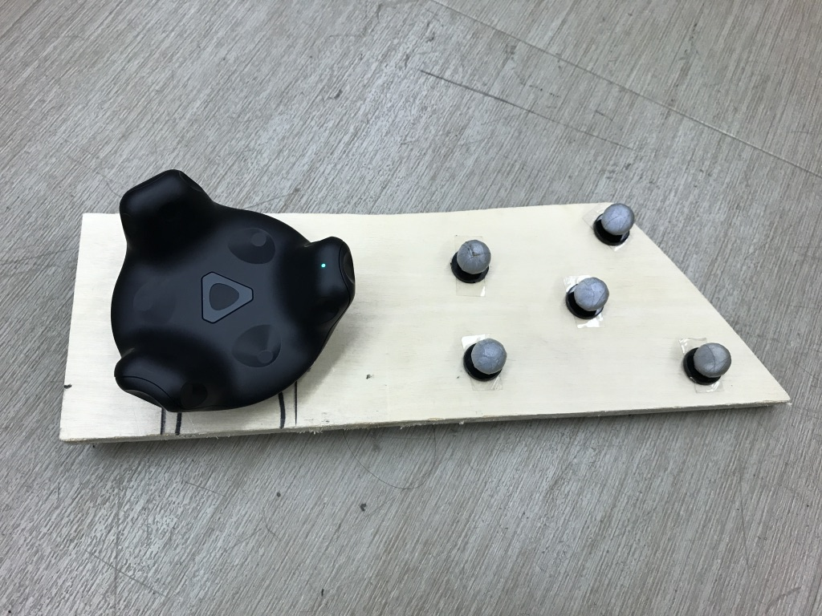
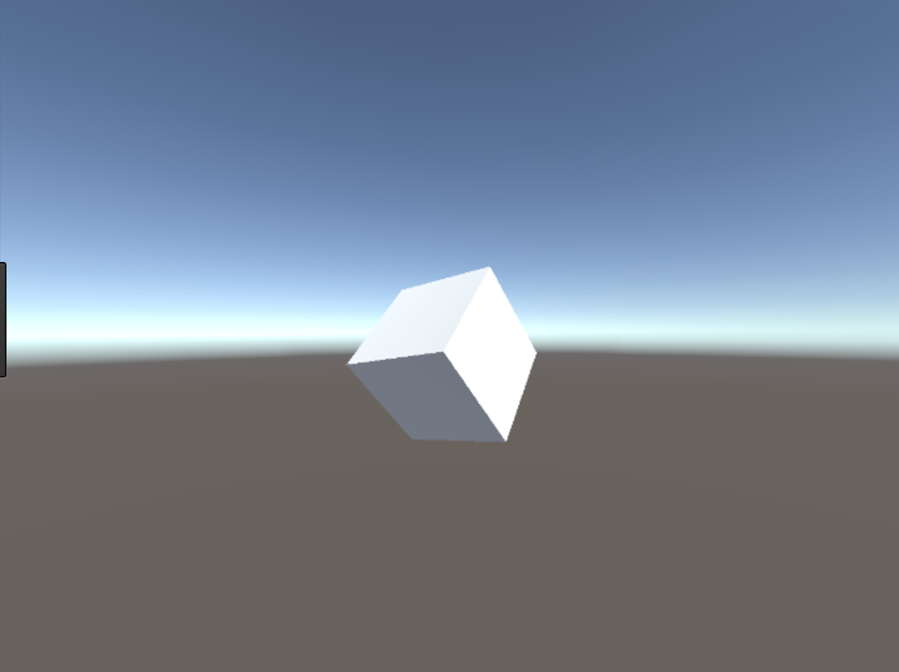
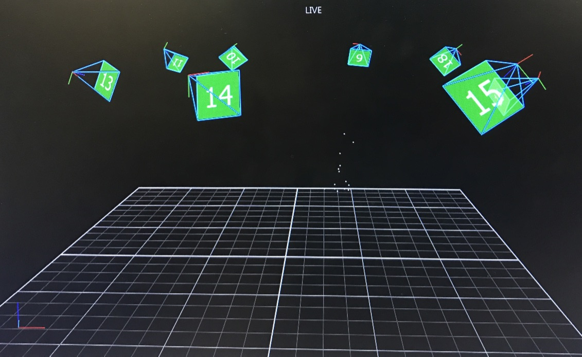
Method
Unity
Vicon

Slide 4
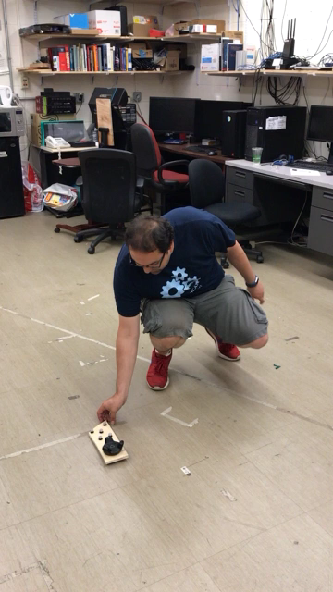
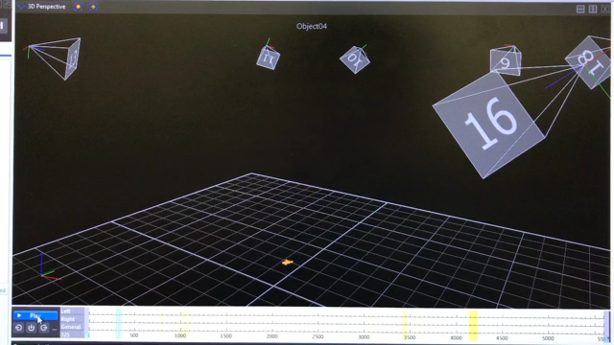
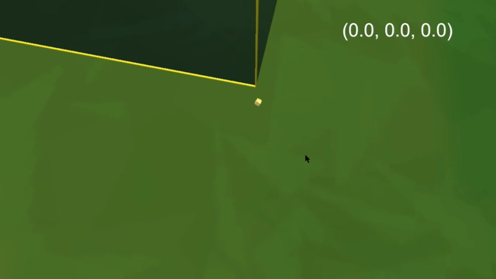
Experiment

Slide 5

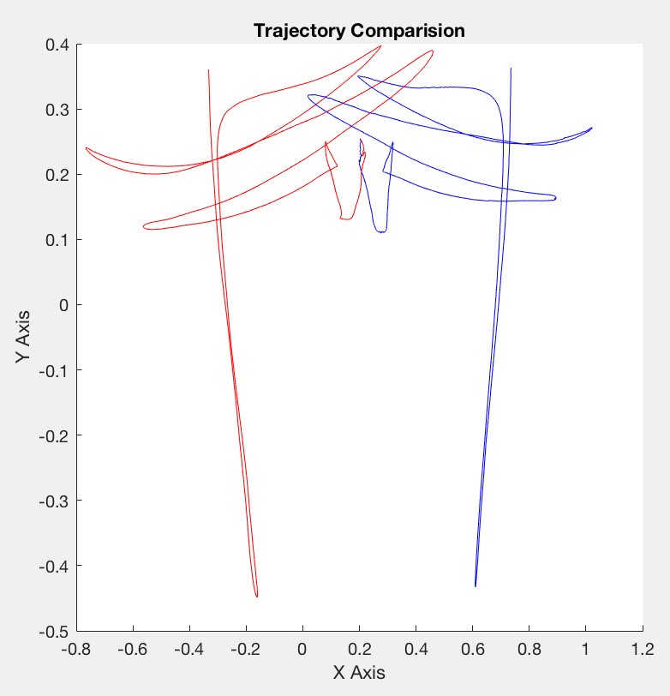
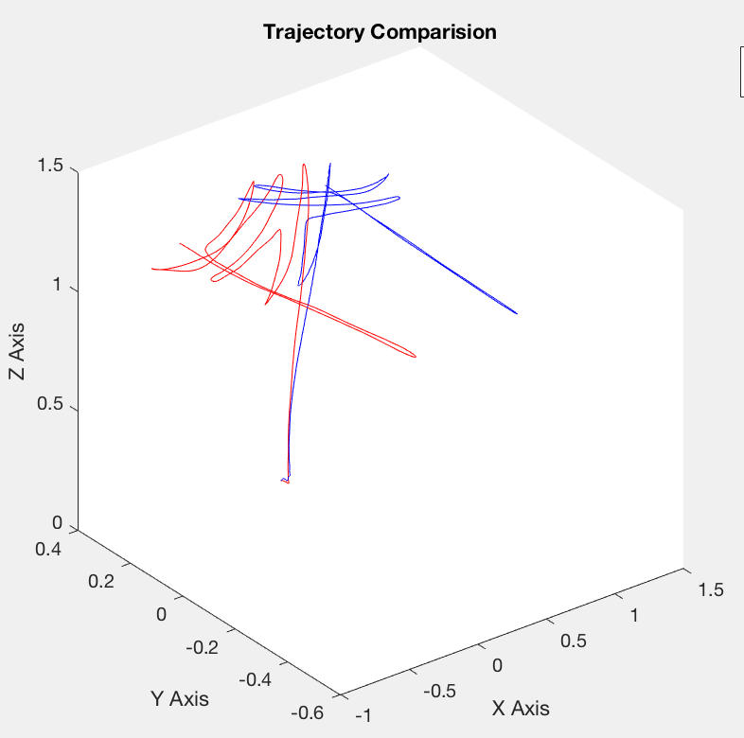
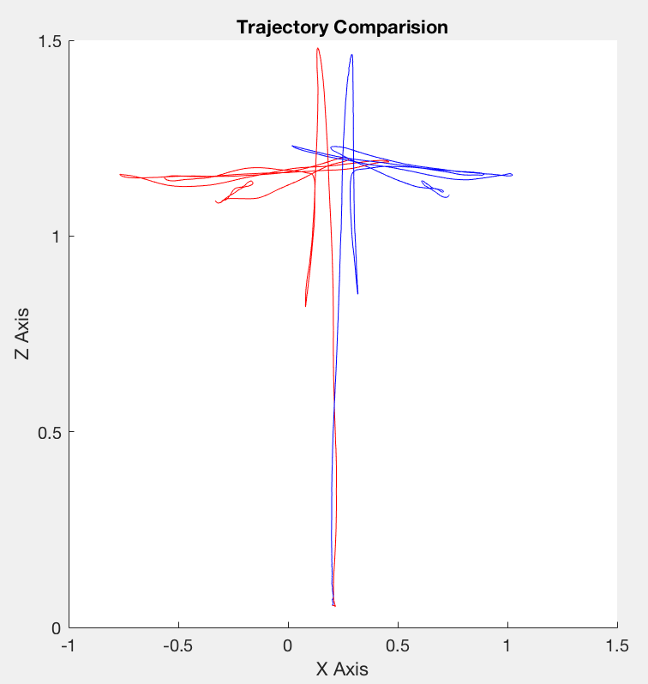
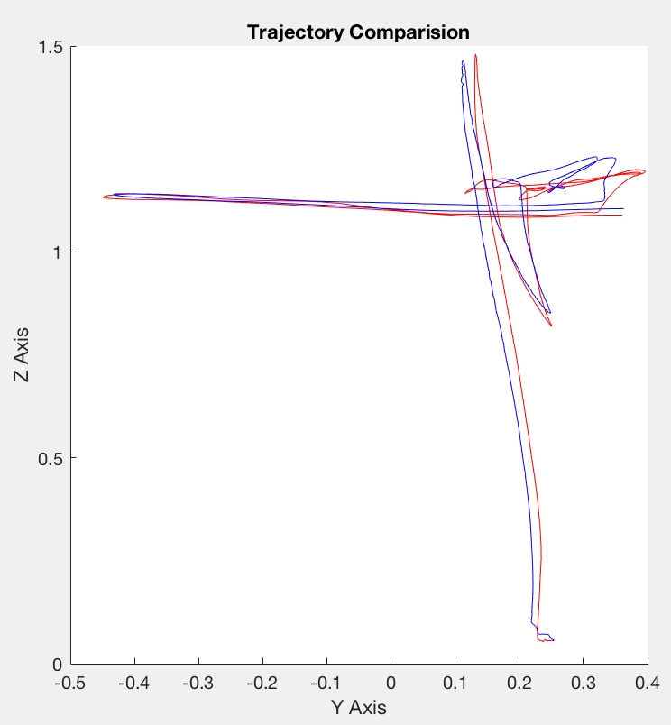
Trajectory
Mapping:Origin,Rotation,Scale(manually)
Symmetrical (left & right hand)

Slide 6
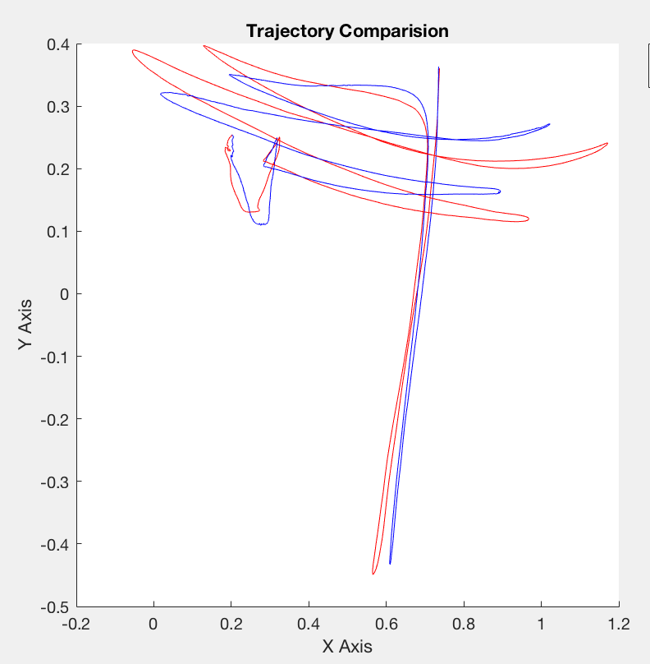
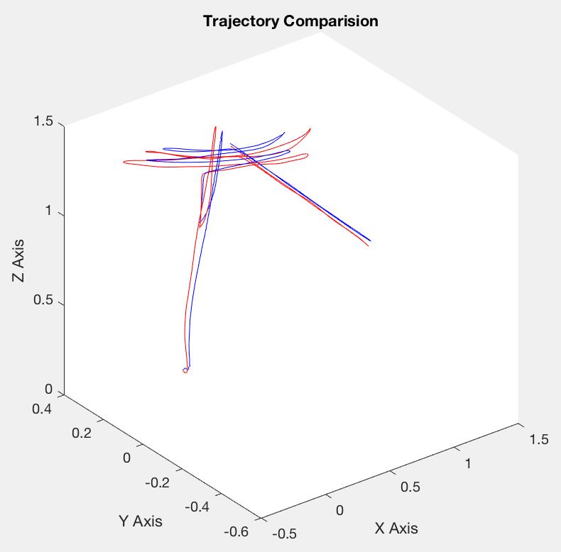
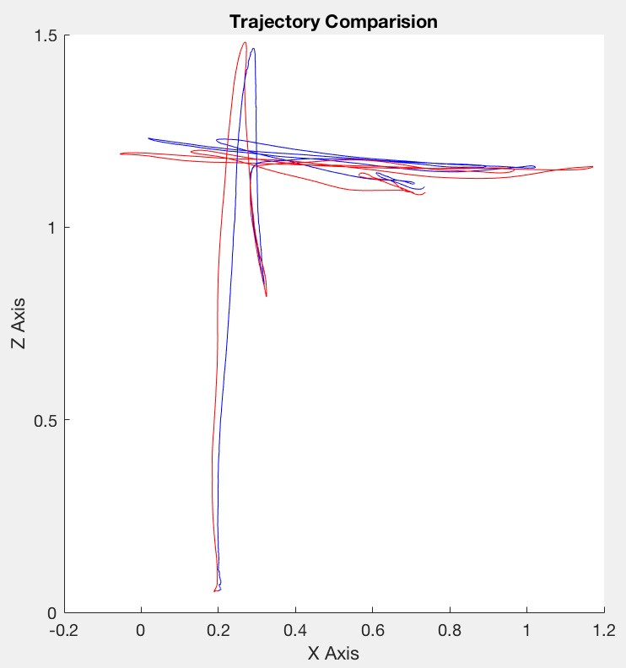
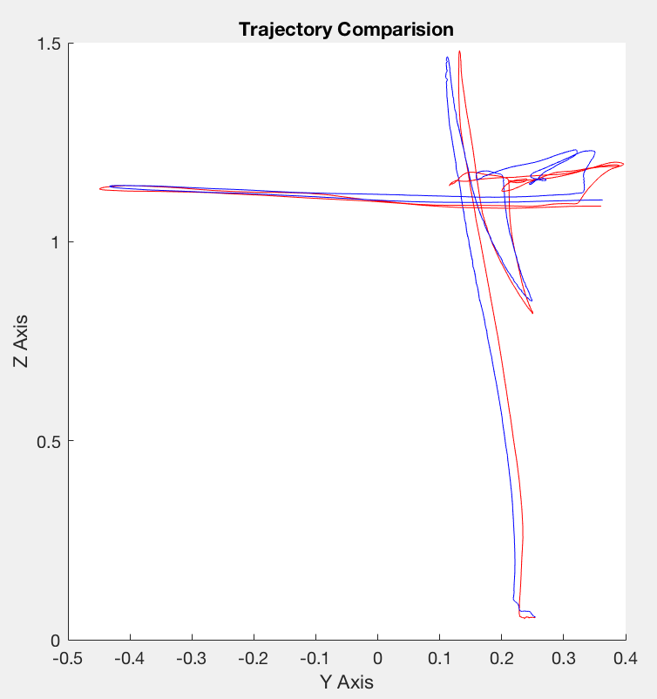
Trajectory
Tracker and one marker
Improve mapping

Slide 7
Next Step
Create a box to put tracker and markers
Consider several markers (as a segment) instead of one marker
Compare trajectory
Gather and compare orientation
Improve code (Unity, Python, MATLAB)

